Slide 1
Employee Wellness Champion
2024-2025
Year-end Meeting
To sign in, please put your name in the chat!

Slide 2
Please sign in by putting your name in the chat!

Slide 3
Your District Wellness Team
Caleigh Hill Employee Wellness Coordinator
hillca@pcsb.org
Brandon McIntosh Employee Wellness Specialist
mcintoshbra@pcsb.org
Jessica O’Connell Aetna Wellness Nurse on-site
pcs.oconnellj@pcsb.org
Darlene Rivers EAP Coordinator on-site
pcs.riversd@pcsb.org
Gabrielle Belcastro Aetna Registered Dietitian
nutritionsupport@pcsb.org
April Paul Director of Risk Management
Caitlin Shetterley Gallagher Client Benefits Administrator

Slide 4
Employee Wellness Program
Vision:
100% productive, healthy and happy employees.
Mission: To promote a culture that supports and encourages healthy behaviors, employee engagement and a balanced state of wellbeing. The districts' wellness initiatives will inspire and empower employees to take responsibility for their own health which is vital to their ability to contribute to the work and mission of PCS.

Slide 5
25 days left of school!

Slide 6
Champion
Attend the champion meetings
Organize wellness programs at your site
Track and record those programs
Communicate to your staff
Be able to answer most questions your employees have

Slide 7
Champion Responsibilities
Meetings |  | Programs
Kick off Meeting Mid Year Meeting Year end meeting | $50 per meeting | Required Financial Program 1 Required Financial Program 2 Additional Program Additional Program | $75 per program
Total Supplement Available: $450 (Up to $150 for all meetings and $300 for all programs)
Must attend at least 1 meeting and record 1 program in EACH semester (2 required programs) to earn any supplement.
Champions will also be responsible for communication to their staff including reading monthly emails and sending the information to their staff. Champions will also provide a wellness board for their site to post wellness information.

Slide 8
Financial Requirement Champions must complete 2 Financial Wellness Programs $75 supplement for each program
Financial Program 1:
Must utilize PCS voluntary retirement vendors
Voluntary Retirement Benefits
FRS/DROP
Social Security
Estate Planning
Student loan Forgiveness
Planning for success
& much more!
Financial Program 2:
Any of options for program 1
5/3 Bank Presentation
EAP financial stress
Nutrition – eating on a budget
Multi-week budgeting & savings program

Slide 9
Financial Program 1 Options
Topics Include:
FRS/DROP Retirement
Maximizing Social Security
Estate Planning & Legacy Planning
Financial Success
Student Loan Forgiveness
Investing
Budgeting
& much more!
No cost to you!

Slide 10
What’s one thing you learned from the financial presentation?
Enter in chat.

Slide 11
Last day to report programs:
FRIDAY, APRIL 25!!!!
Email Brandon McIntosh mcintoshbra@pcsb.org your proof of completion.

Slide 12
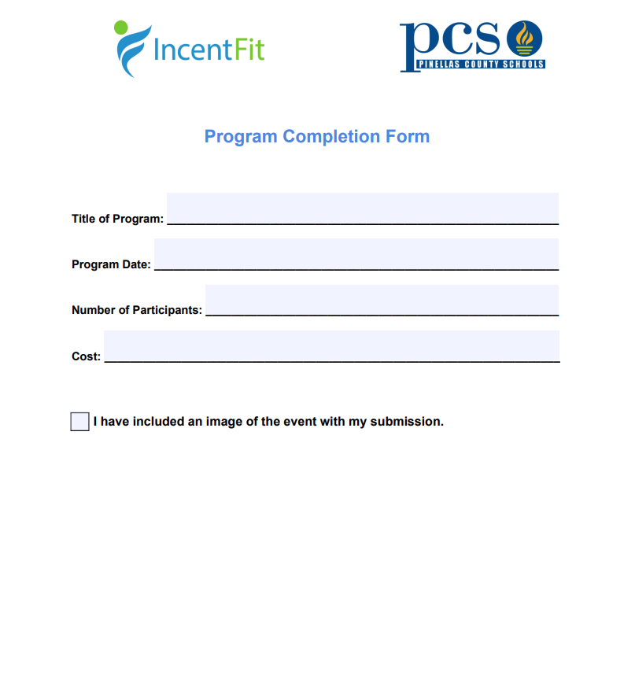
Submit all proof of completions to mcintoshbra@pcsb.org

Slide 13
Last day to use budget is
May 15, 2025

Slide 14
Schedule
Submit all programs by this Friday, April 25 to Brandon!
Our team will be approving organizing supplements
We will EMAIL you your expected supplement. You will have a certain date you’ll have to respond by if there’s any issues.
Your supplement will be added to your last paycheck of the year.

Slide 15
Champion Program Highlights!

Slide 16
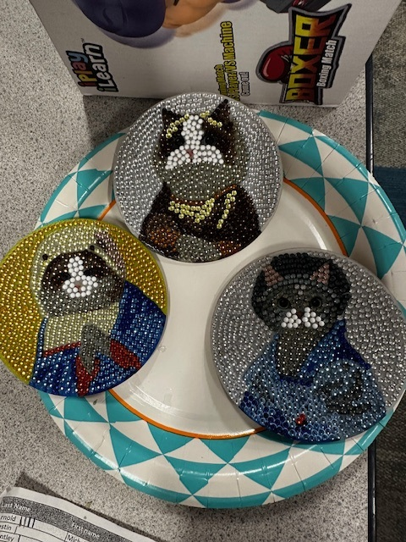
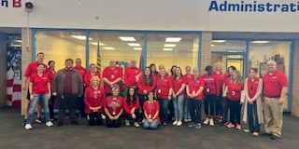
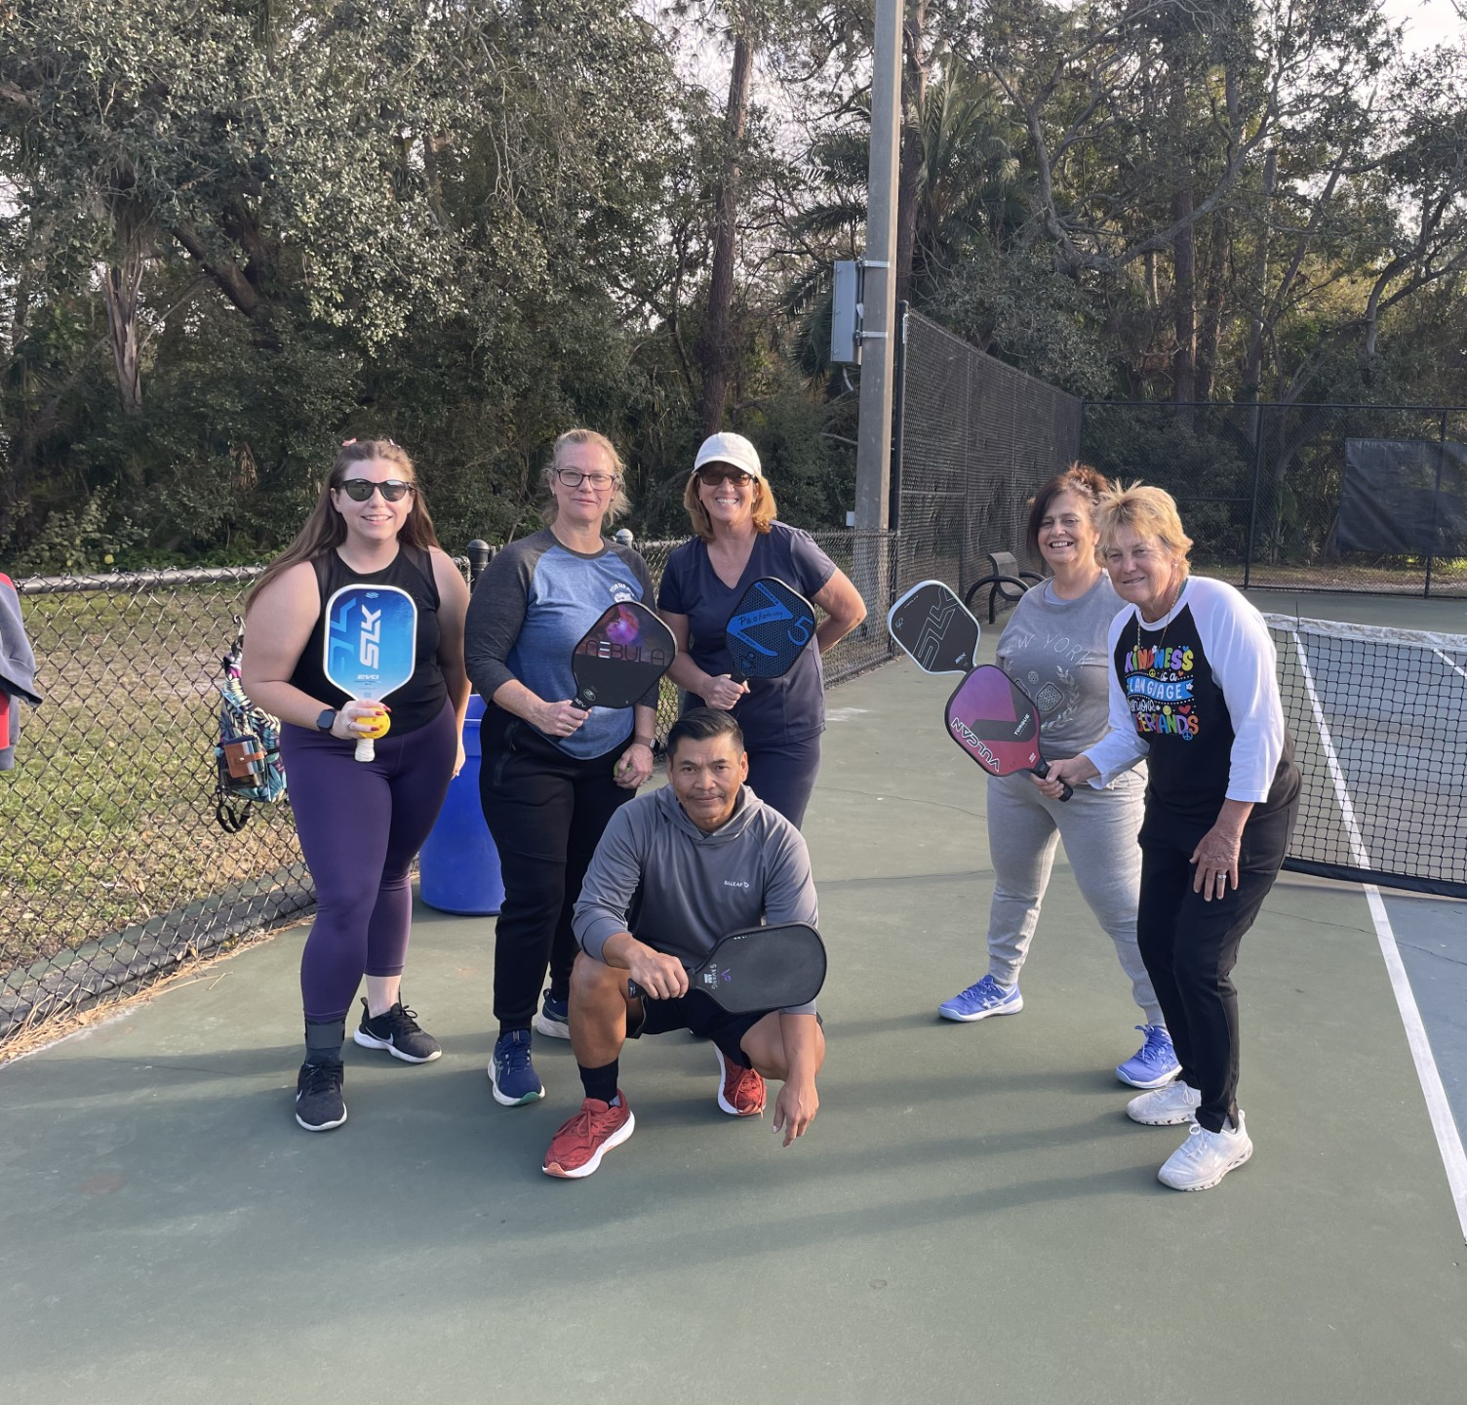
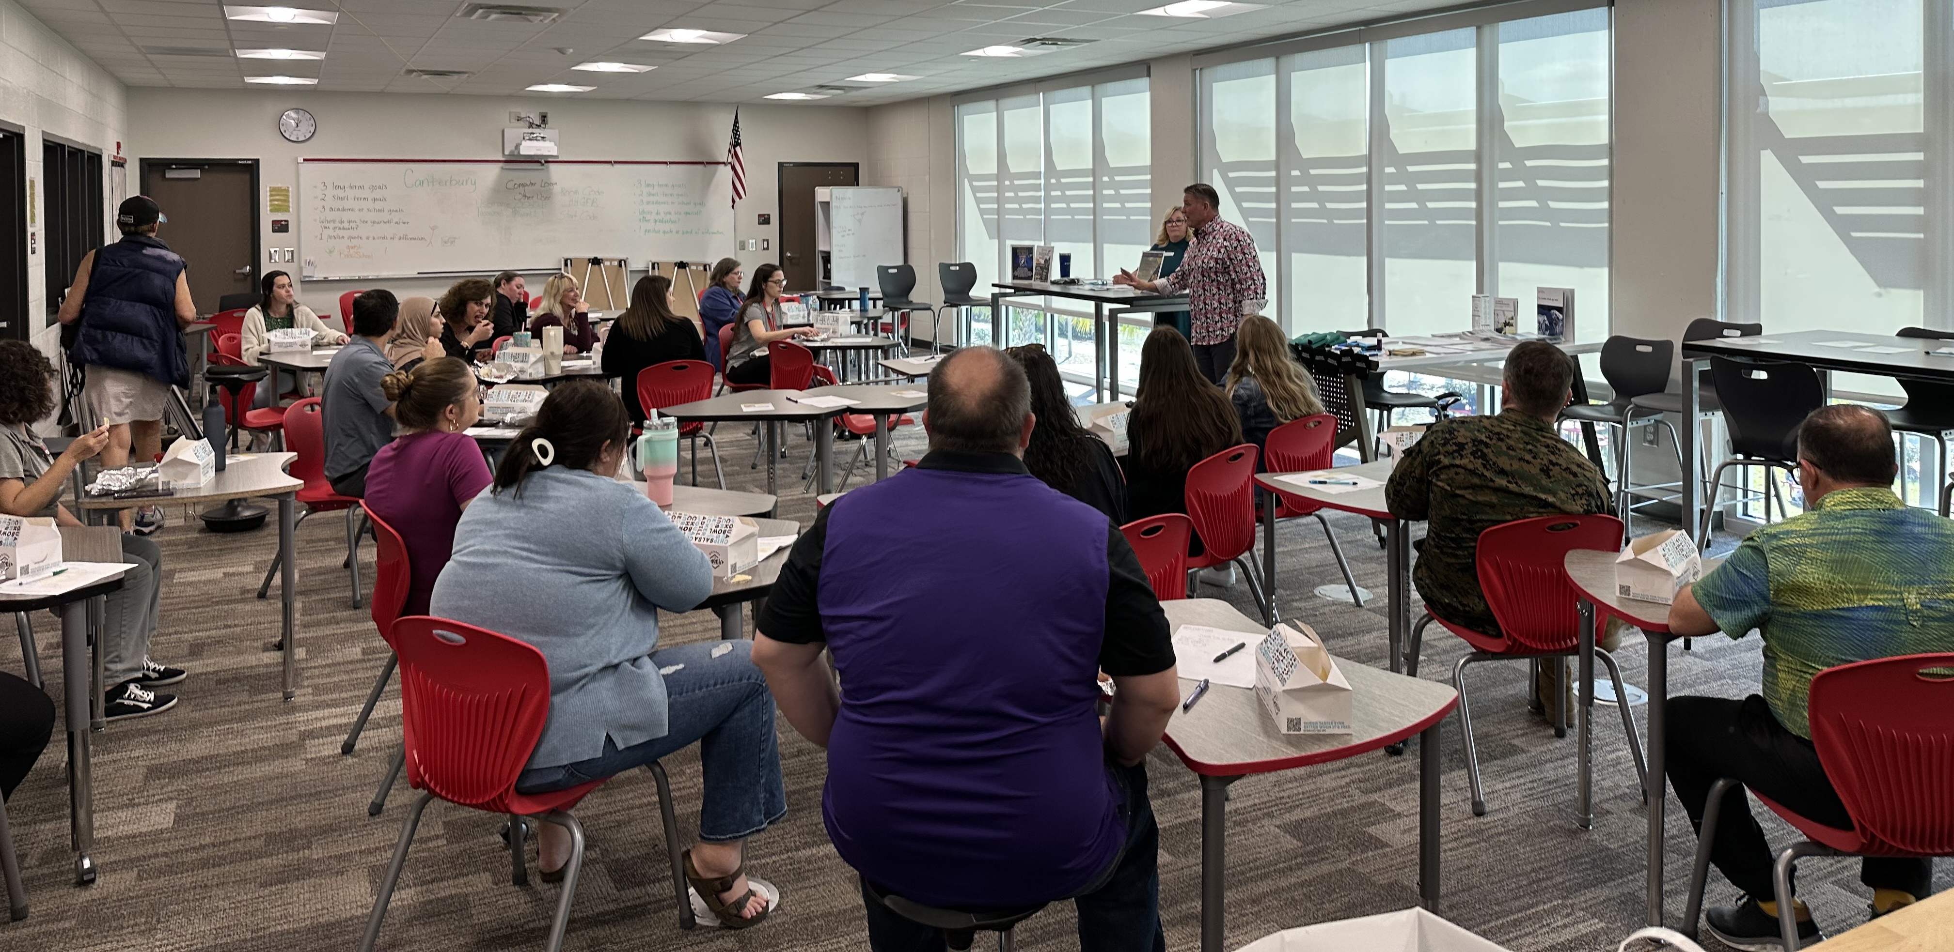
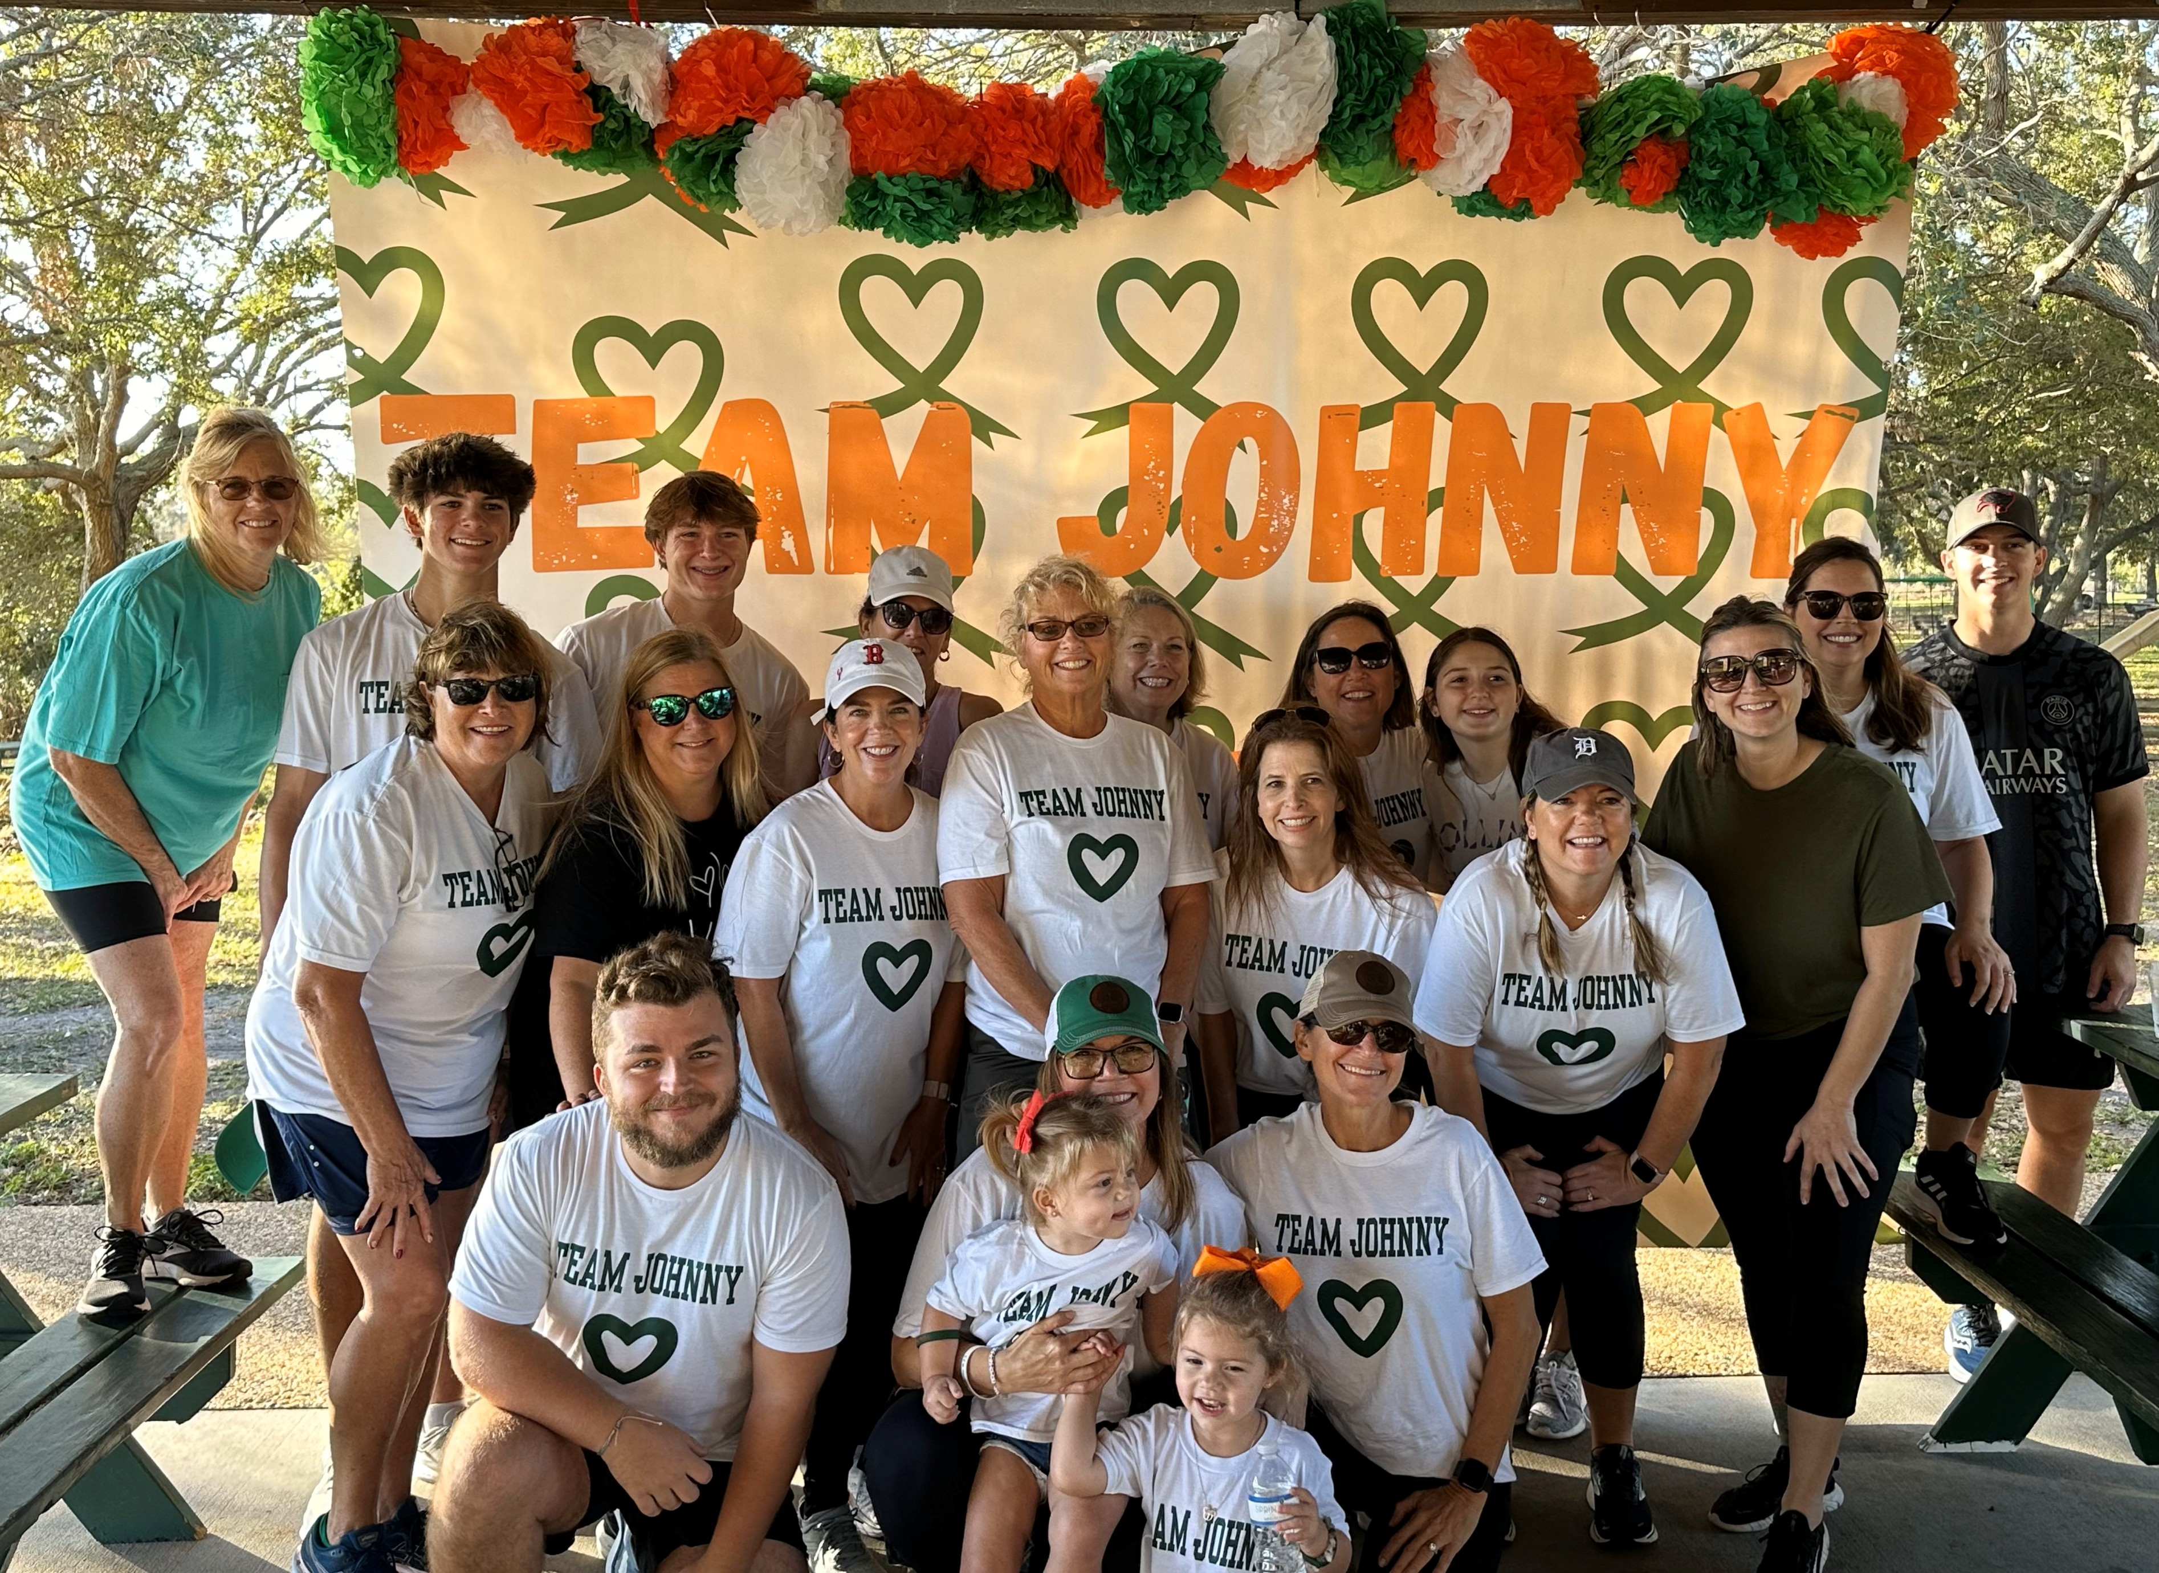
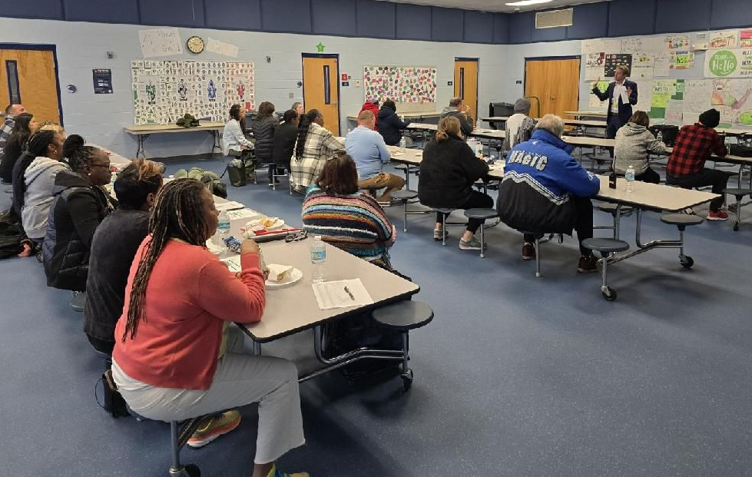

Slide 17
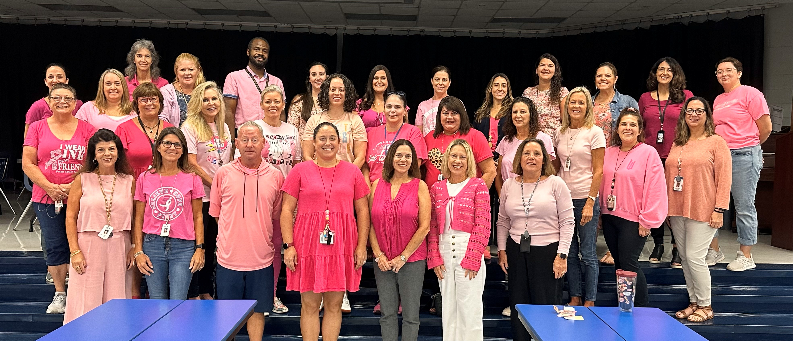
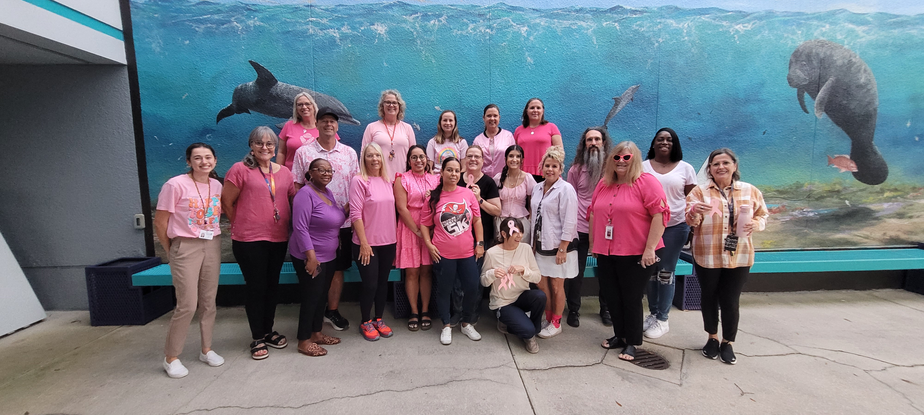
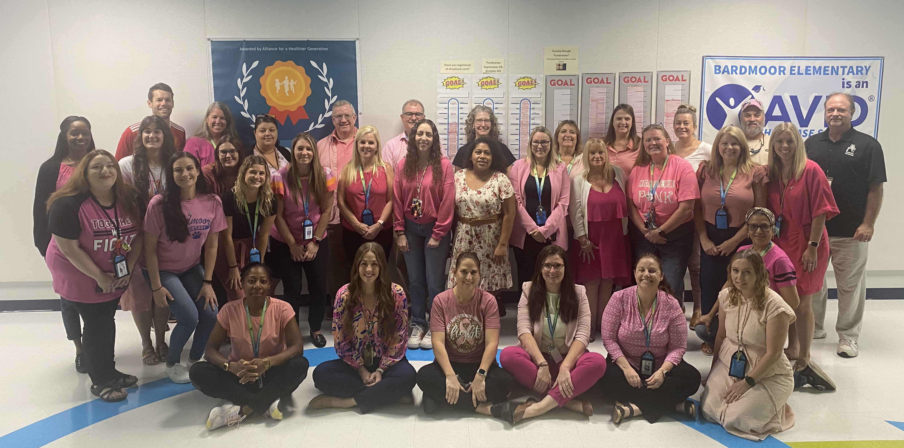
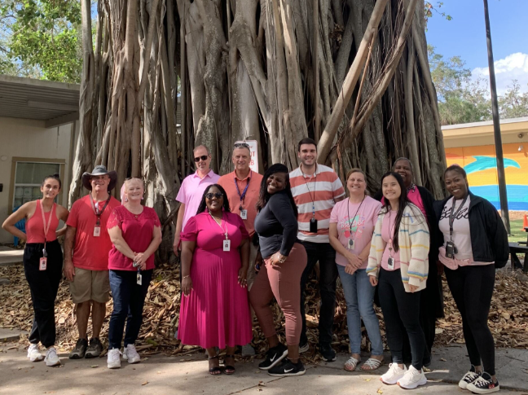
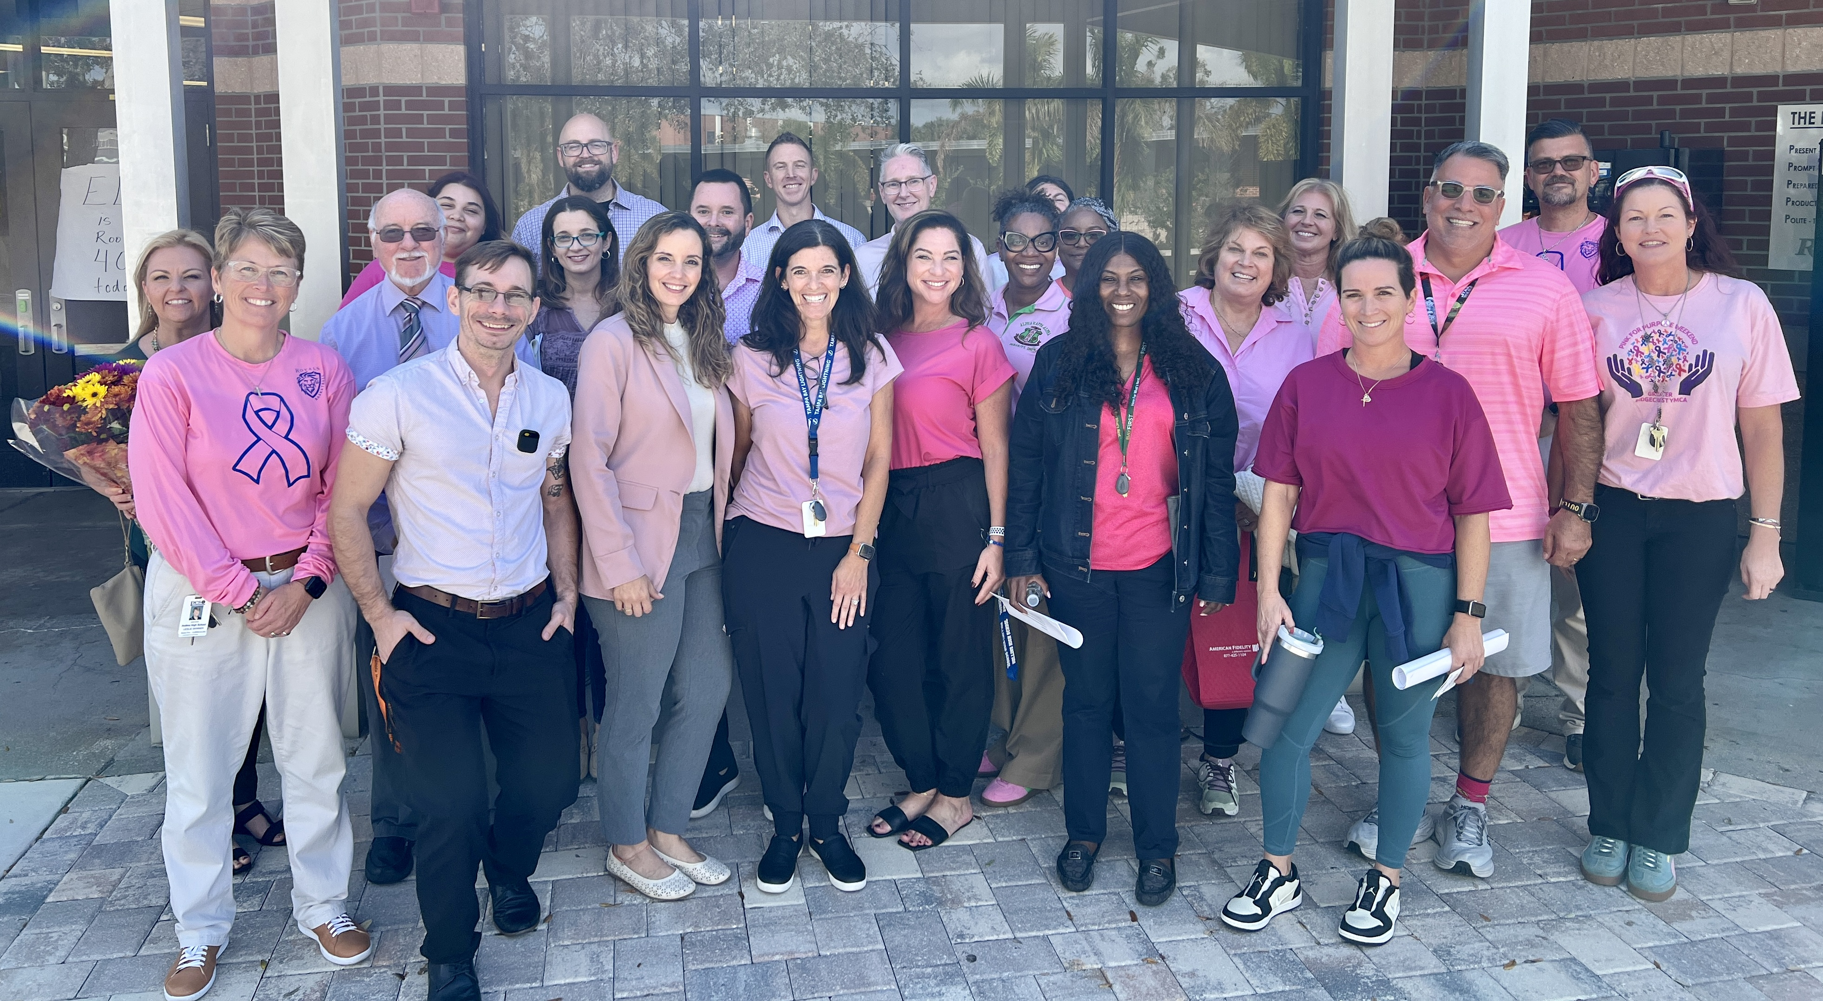
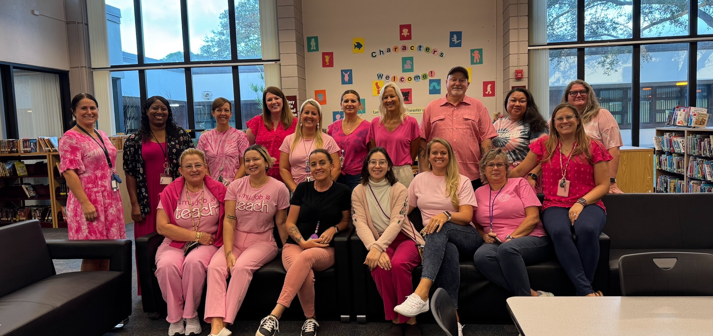

Slide 18
Have a favorite program? Please share!

Slide 19
2024-2025 EWC Awards

Slide 20
Champions who went above and beyond: Completed 5 or more programs (so far)
Allison Swank Jennifer Brose Pamela DeNinno-Megura
Amy Rosado Jennifer Bryant Raquel Stiehler
Bonnie Capra Jennifer Kelly Rebecca Lang
Caroline Goff Jennifer Nicastro Travis Broome
Jennifer Velez Wendy Seslowsky
Cheryl Wright Julia Sweeney
Colleen Rafferty Katelyn Pellin
Emily Brochu Kathleen Jones
Francesca Futia Kerri-Ann Henry
Haley Kukoleck Kimberly White
Hollisa Miller Lisa Visco
JaVonda Bryant Nicola Repetosky

Slide 21
Overcoming obstacles
Jill Rollo and Rebecca Lang
Madeira Beach
Jennifer Kelly
Gulf Beaches
Natalee Cleveland & Shanna Walker
Disston Academy & Lealman Innovation
& all champions who were impacted by the Hurricanes.

Slide 22
Most financial programs completed:
Notes:
4 financial programs

Slide 23
Most financial programs completed:
Julia Sweeney- Safety Harbor Middle School
Notes:
4 financial programs

Slide 24
Rookies of the Year!

Slide 25
Rookies of the Year!
Kerri Ann Henry – Walter Pownall Service Center Travis Broome – Brooker Creek Elementary

Slide 26
2025 Champion Award!

Slide 27
2025 Champion Award!
Bonnie Capra – PTC St. Petersburg

Slide 28
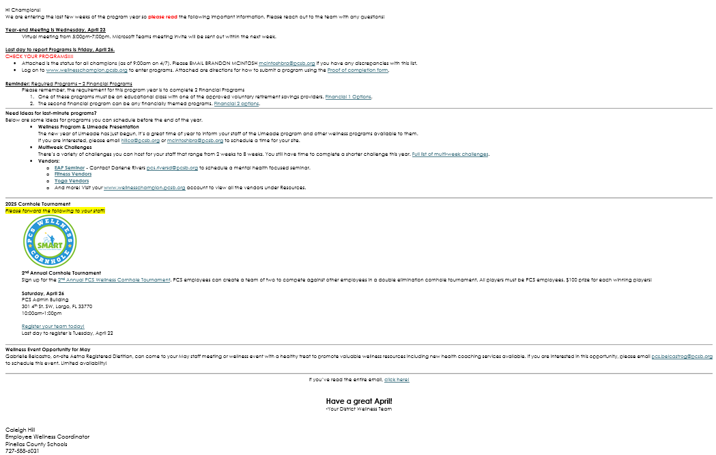
Did you read the full email?

Slide 30
Only 13 champions clicked on this link…
Kerri Ann Henry
Naomi Middlebrooks
Joanne Derenzo
Melanie Attardo
Kathleen Wileman
Jill Rollo
Katelyn Pellin
Zee Knight
Javonda Bryant
Regan Stevens
Betty Scott
Toni Hoge
Jennifer McIntosh

Slide 31
Only 12 champions clicked on this link…
Jill Rollo

Slide 32
Cornhole Tournament
Saturday, April 26
PCS Administration Building
Gates open at 9:00am
Games start at 10:00am
Food, games, and fun!

Slide 33
Year-end Reports

Slide 36
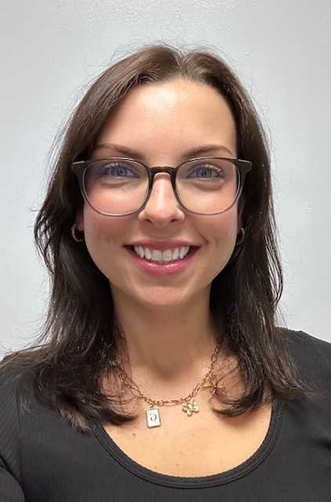
Nutrition Coaching with Gabrielle Belcastro, RD
Receive FREE nutrition coaching sessions with on-site Aetna Registered Dietitian, Gabrielle Belcastro.
To make an appointment or for more information, email nutritionsupport@pcsb.org
Take charge of your health with personalized coaching services. Complimentary coaching services available for:
Diabetes
Prediabetes
Weight Loss (BMI>30)
GLP1 Medication support
High Blood Pressure
High Cholesterol
Open to all PCS employees with the Aetna medical insurance.

Slide 37
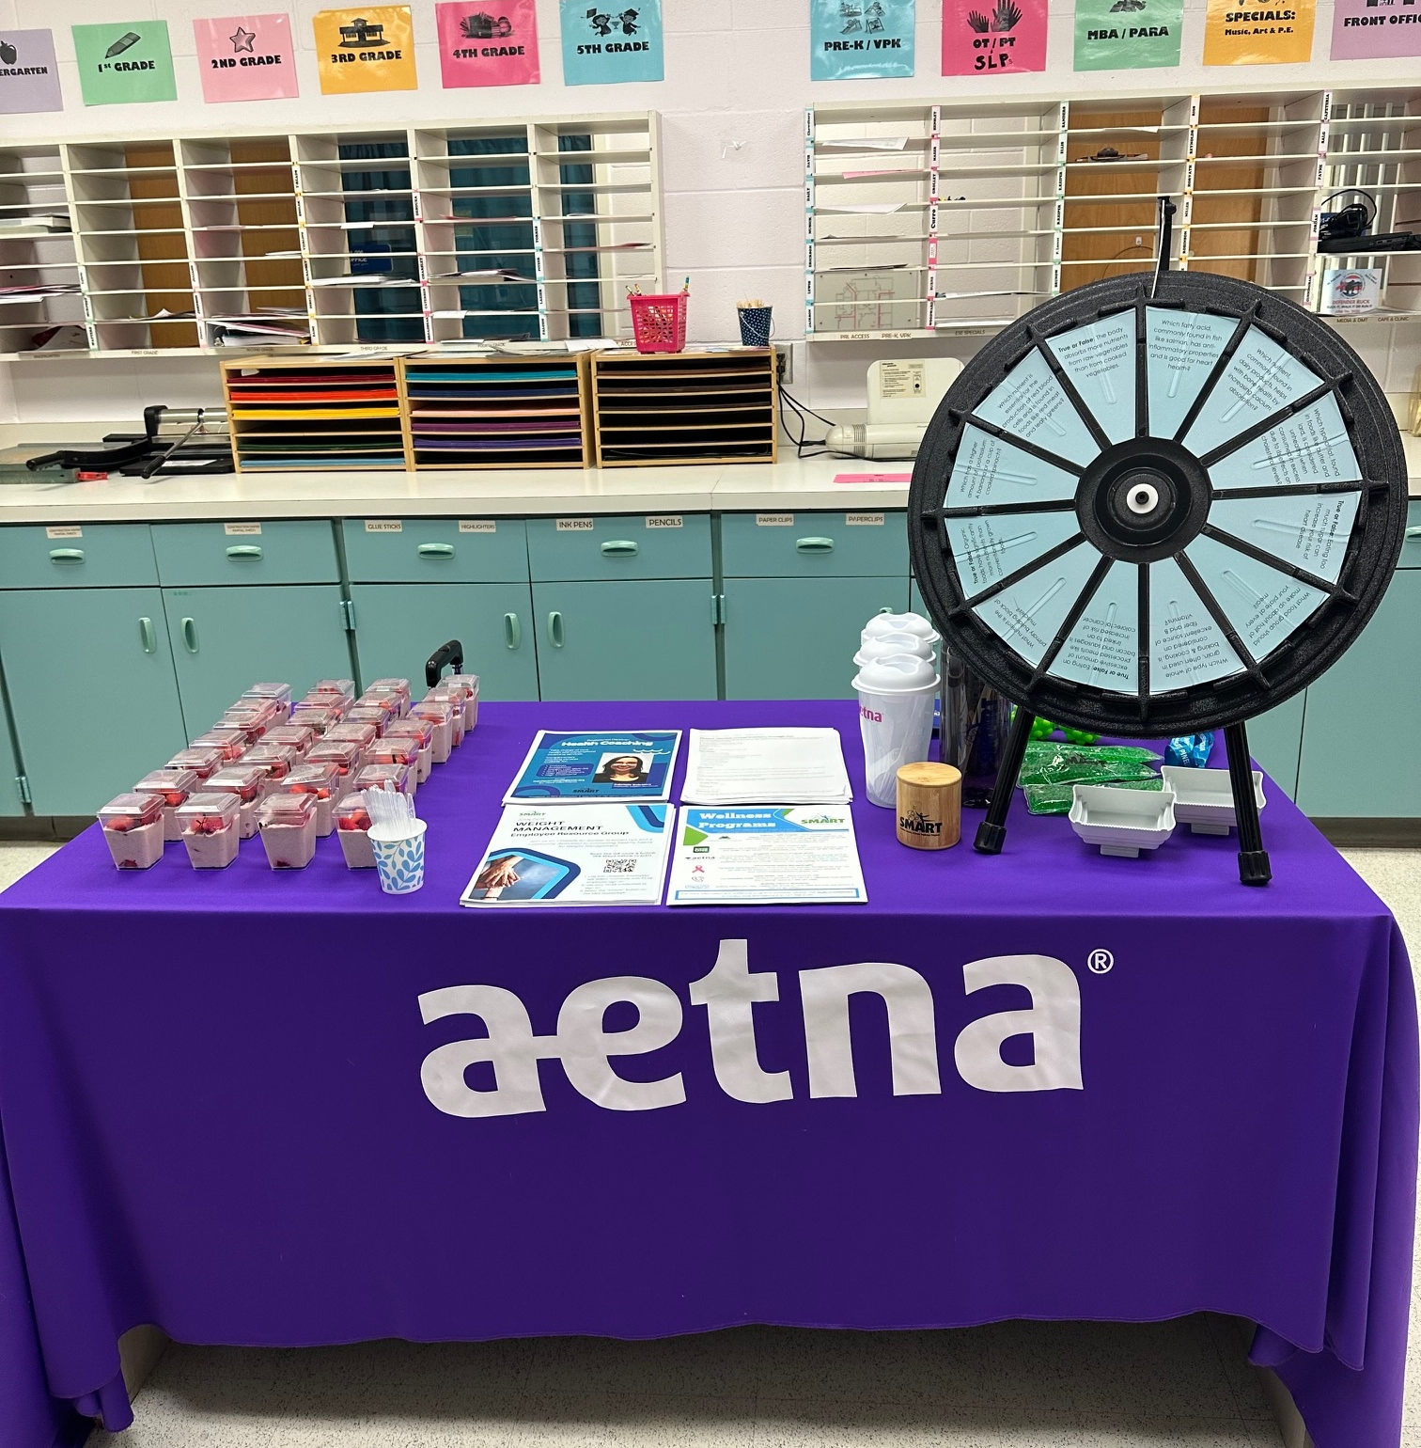
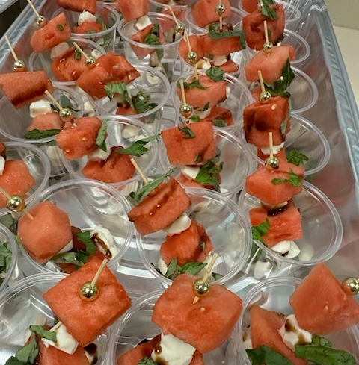
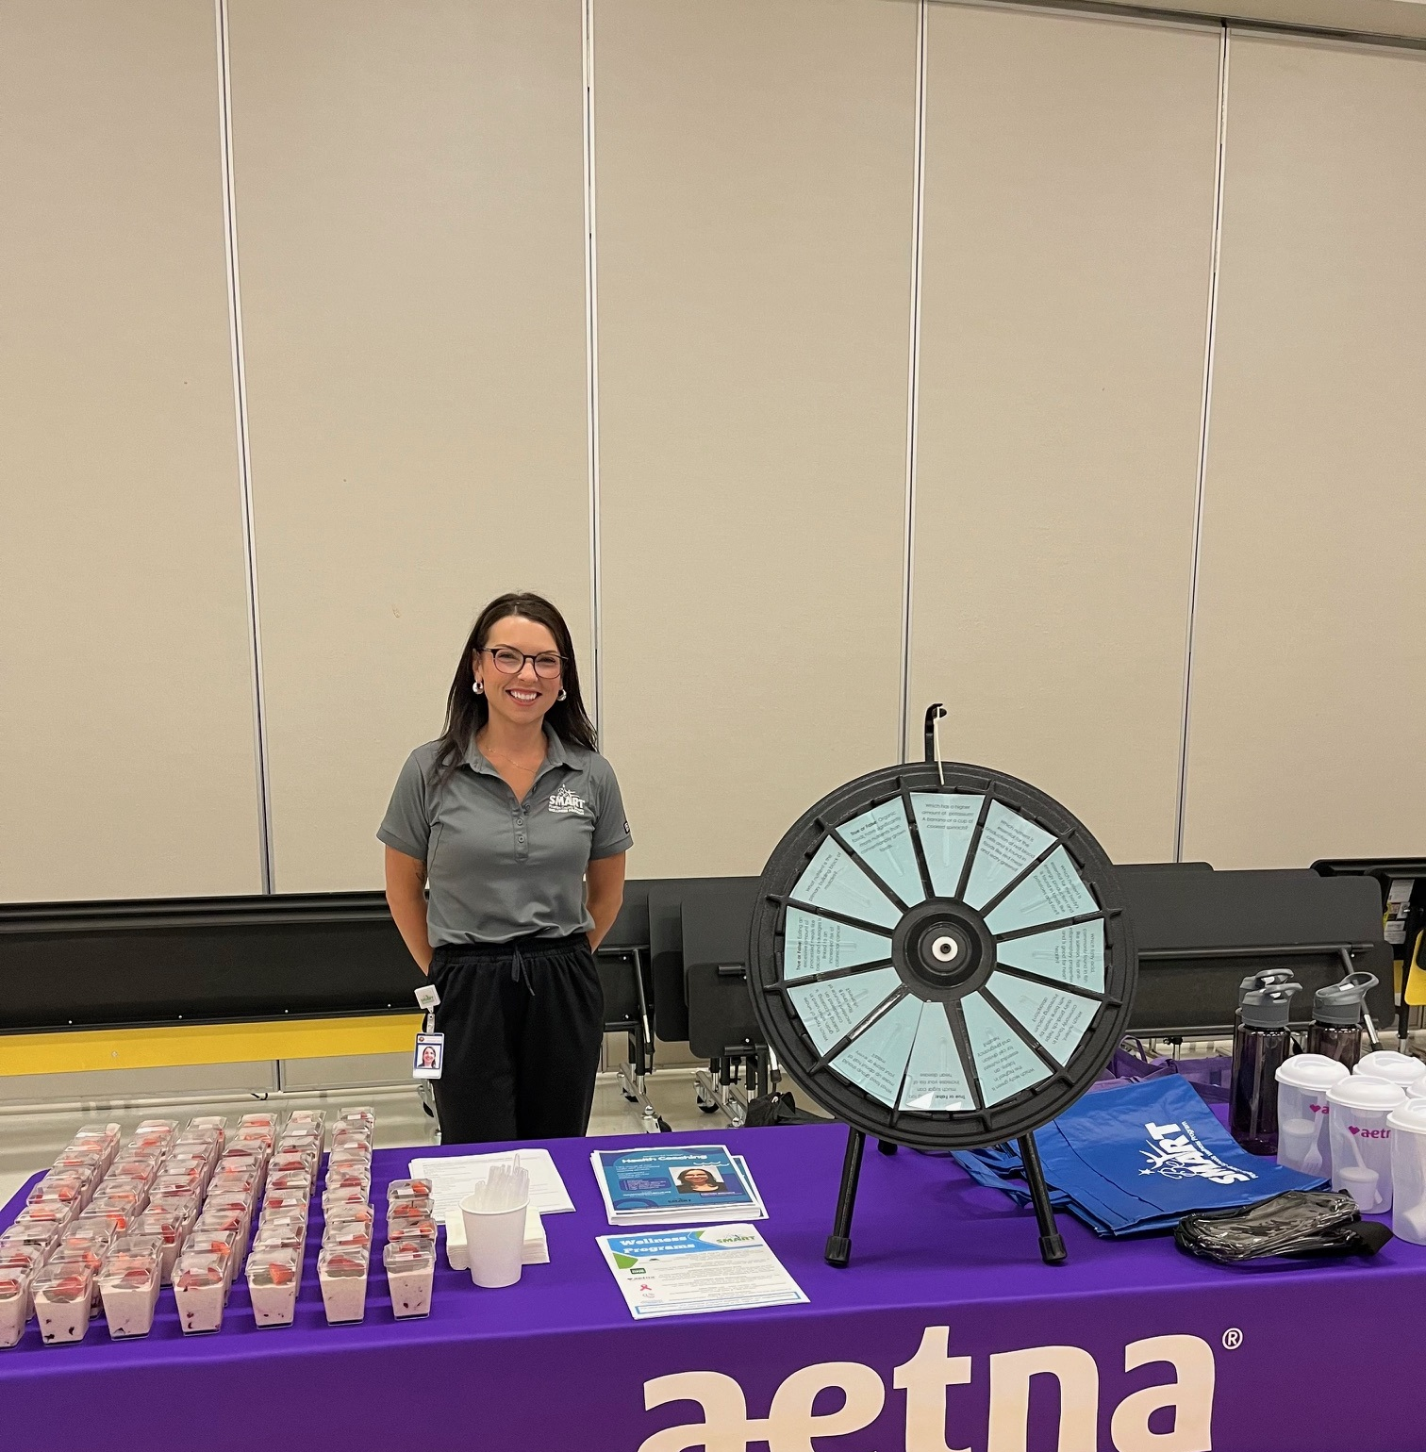
Opportunity to promote Nutrition Coaching at your worksite!
Email pcs.belcastrog@pcsb.org to schedule your site’s visit!

Slide 38
Employee Assistance Program (EAP) 2024
Aetna Resources for Living EAP offers up to 8 FREE sessions per incident with a licensed professional for staff and family members living in the home.
 | 2023 | 2024
Utilization rate* | 19.0% | 16.0%
Total Unique Members Served | 1,346 | 1,161
Total Authorizations | 1,050 | 965
Average Sessions per Case | 5.1 | 4.6
On-site Presentation 2024
Top 3 Presenting Issues 2024
 | 2023 | 2024
Relationship: Marital/Sign. Other | 13.8% | 16.0%
Anxiety | 13.8% | 12.8%
Stress/Distress | 11.5% | 11.2%
Number of Trainings | Number of Employees Reached
93 | 2,642
Utilization
Modality
38
*Utilization rate: (Total Member Services + Critical Incident Consultation + Critical Incident On-Site Participants + Management Consultations) / Total Covered Employees

Slide 39
Darlene Rivers On-site EAP Coordinator pcs.riversd@pcsb.org or 727-588-6507
EAP
Employee Assistance Program provides short-term problem resolutions and in-the-moment support for all PCS employees and their household for FREE!
Up to 8 counseling sessions per issue
24/7 support including in-the-moment support
Partners with Talkspace – talk to a counselor through text, audio, or video messages.
NEW! Wellbeing coaching available
You don’t need counseling but still want guidance/accountability in goals and other well-being initiatives in your life.
Goal setting
No limit of sessions
Certified life coaches

Slide 40
AdventHealth Mobile Mammography
www.AdventHealthMobileMammography.com
As of Spring Break
Total Number of Sites | 64
Total Number Screened | 719
Total Projected Sites | 109
Referral Rate | 7.1%

Slide 41
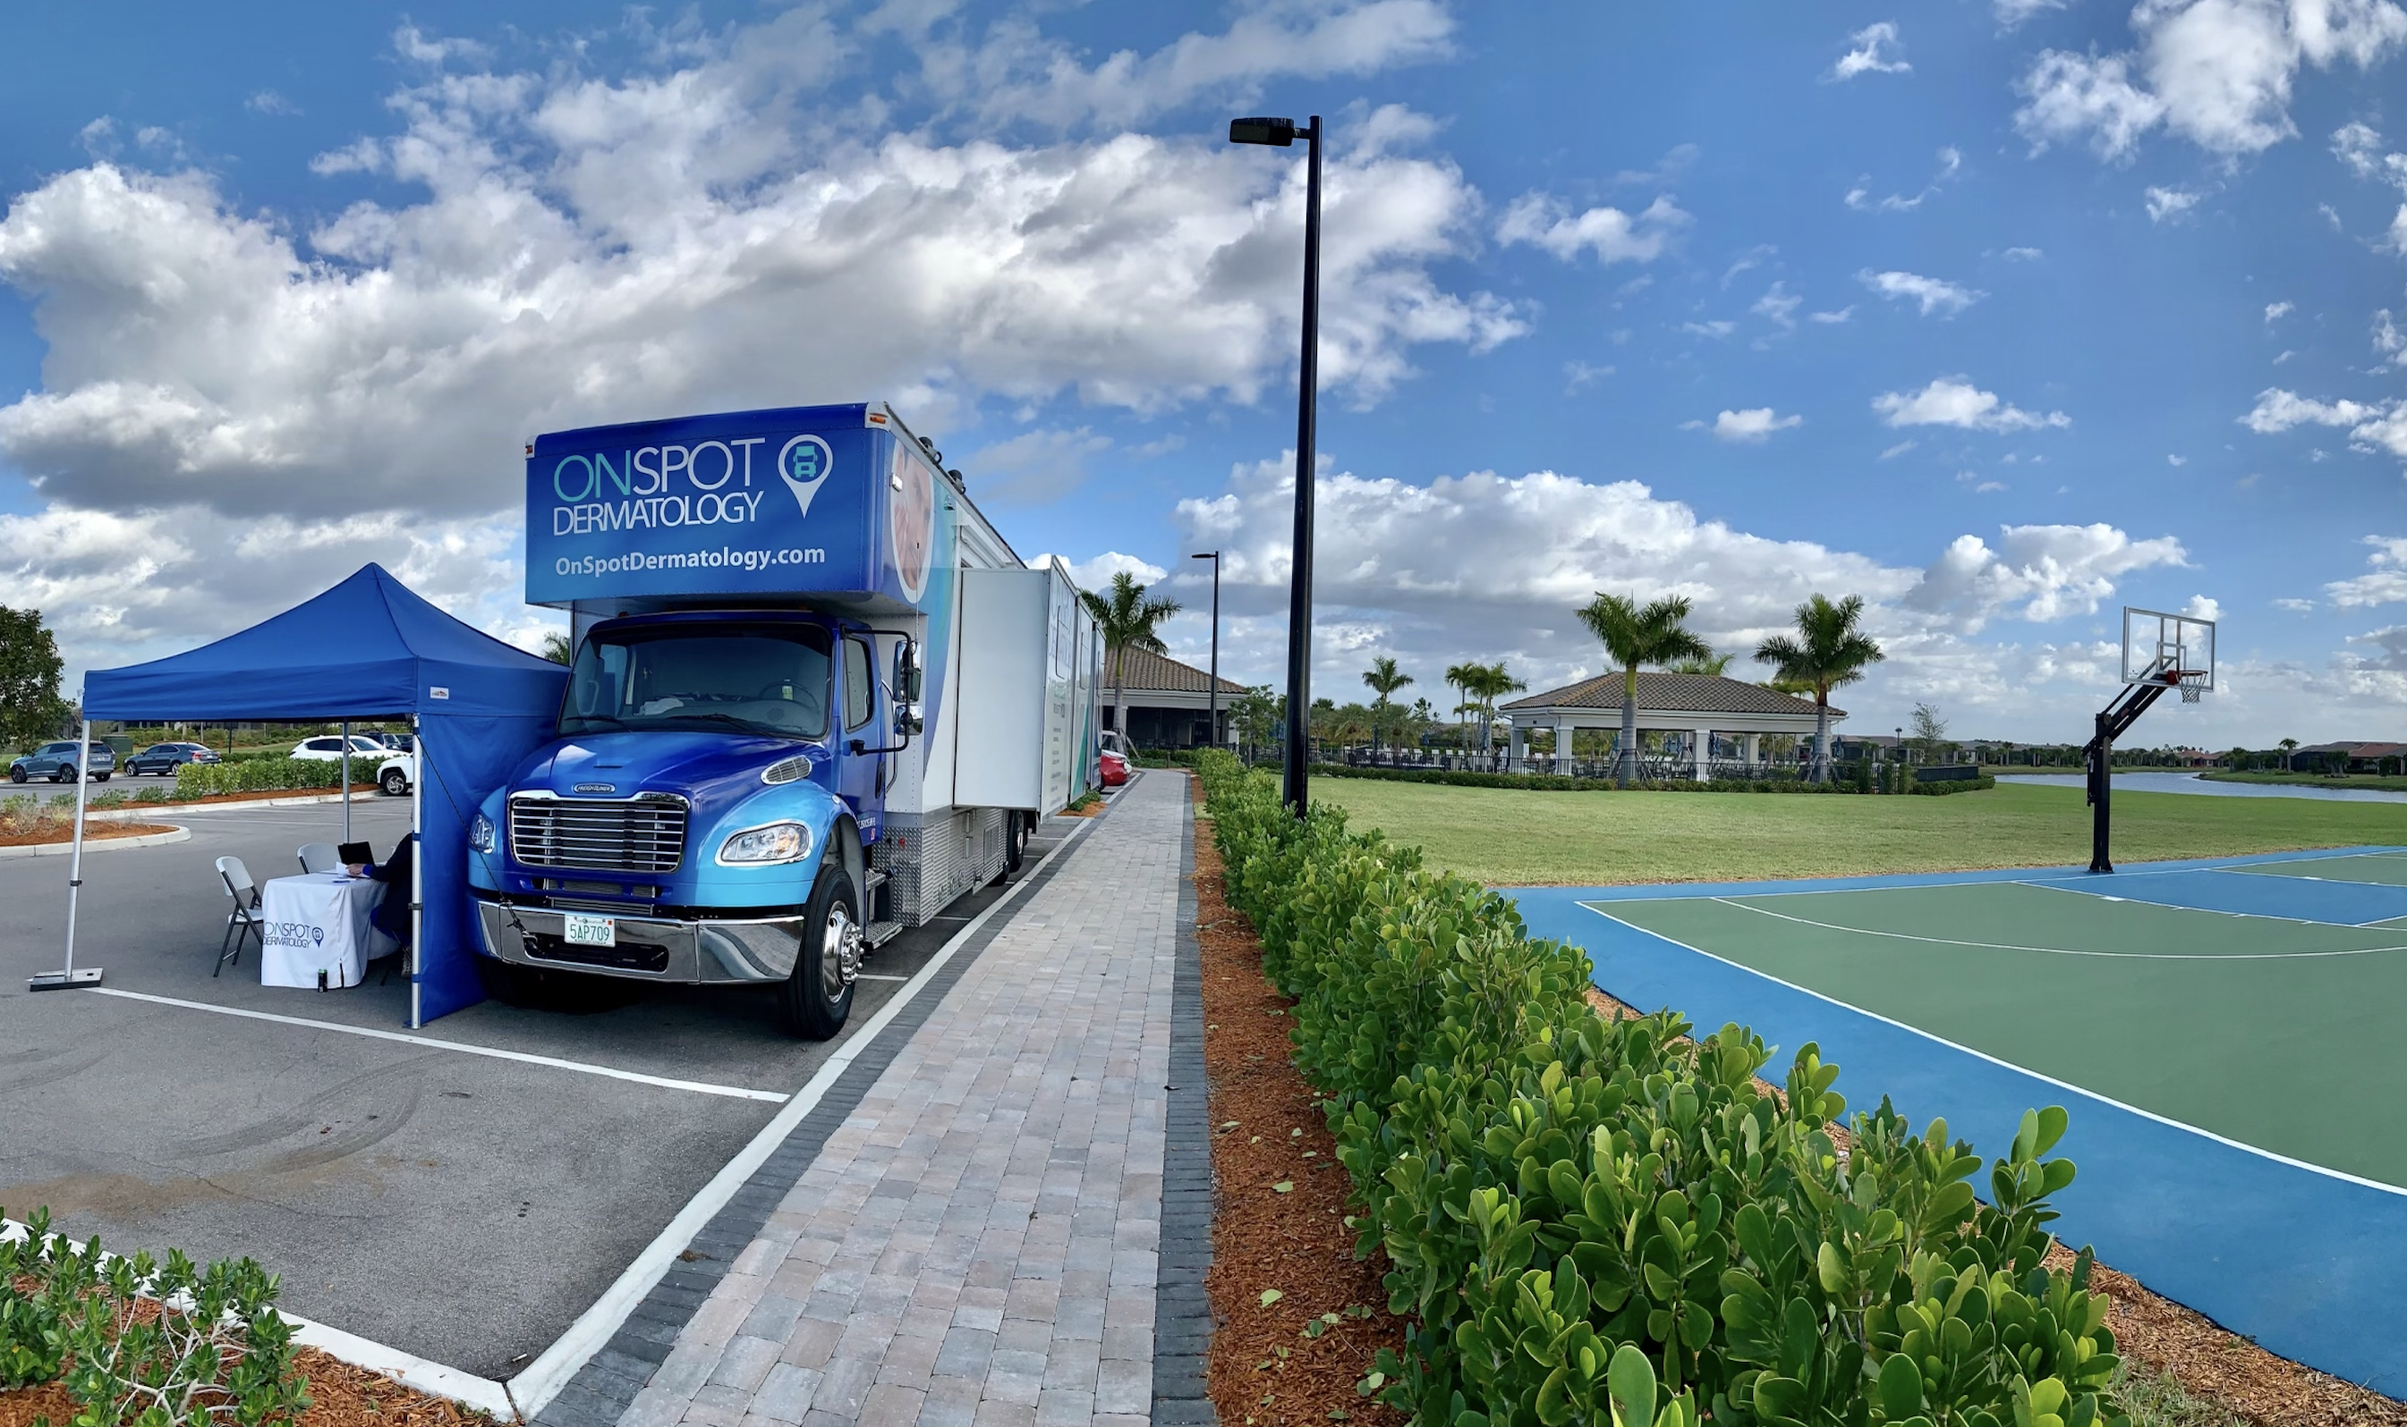
On-Spot Dermatology
As of Spring Break
Total Number of Sites | 28
Total Number Screened | 538
Total Projected Sites | 39
Findings
Precancer | 15
Skin Cancer | 30
Melanoma | 2

Slide 42
Limeade 2024 March 1, 2024 – February 20, 2025
 | 2023 | 2024 | BoB
Users Registered | 54% of eligible | 66% of eligible | 42%
Monthly Active Users | 42% of registered | 47% of registered | 29%
User Satisfaction | 4.7/5 | 4.7/5 | 4.5/5
Level​ | Points​ | Employee | Dependent Spouses & Retiree | Employee Level Achievement for 2024 PY
1 | 1,000 * | $20 TANGO gift card | $20 TANGO gift card | 40.2%
2 | 2,000​ | $50 TANGO gift card | $20 TANGO gift card | 31.7%
3 | 3,000 | $300 Annual Wellness Incentive Added to paycheck after program year ends. Must be an active PCS employee with PCS medical insurance at the time of payout. | $20 TANGO gift card | 24.1%
4 | 4,000​ | $75 TANGO gift card | $20 TANGO gift card | 13.9%
Well-being Assessment (Scores out of 5.0)
Strengths | Opportunities
Smoke-Free 4.9 | Healthy Weight 2.8
Drinking Moderately 4.6 | Energy Level 2.9
Job Satisfaction 4.4 | Square Deal 3.1
Job Meaning 4.4 | Financial Wellbeing 3.3
Positive Relationship 4.4 | Sleep 3.3
Level 3 Engagement in Limeade
2021 | 2022 | 2023 | 2024
22.3% | 20.3% | 23.9% | 24.1%

Slide 43
Preventative Exams
Top 5 Completed Activities
1. | Take the Wellbeing Assessment
2. | Get Moving at a Fitness Event
3. | Annual Physical Exam
4. | Mammogram
5. | Well Woman Exam
Limeade awards points for the following preventative exams:
Annual Physical
Well Woman Exam
Mammogram
Colonoscopy
Skin Cancer Screening
Dental Exam/Cleaning
Vision Exam
Flu/Covid Vaccine
Preventative Exams
2024 Aetna Medical Annual Review
 | 2023 | 2024 | Benchmark
Mammogram/Breast cancer | 49.6% | 51% | 37.2%
Pap Smear/Cervical cancer | 23.3% | 23.5% | 21%
Colorectal cancer | 14.1% | 14.3% | 12.1%
Adult preventive care visits age 20-64 years | 33.8% | 34.8% | 30.8%
Benchmark is Aetna commercial book of business

Slide 45
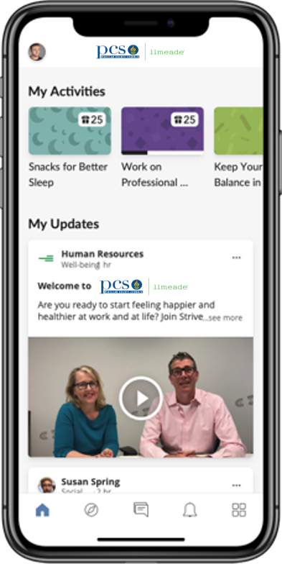
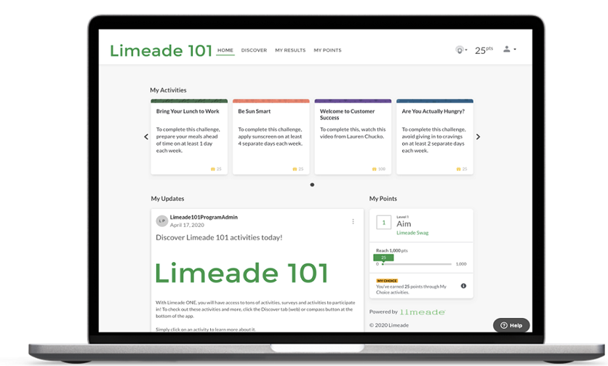
Contact the Wellness Team for an on-site presentation!
March 1, 2025-February 17, 2026

Slide 46
Who’s Eligible?
All employees with Aetna Medical Insurance through PCS
Dependent Spouses (under the medical insurance)
Retirees with Aetna medical insurance through PCS
Dependent Spouses of Retirees (under the medical insurance)
All Wellness Champions regardless of insurance coverage will have access! Champions without the health insurance through PCS will not be eligible for incentives.

Slide 47
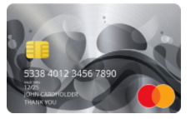
LEVEL​ | POINTS​ | Employee Reward | Spouse & Retiree Reward Including 2 Board Spouse
1 | 1,000 * | $20 TANGO gift card | $20 TANGO gift card
2 | 2,000​ | $50 TANGO gift card | $20 TANGO gift card
3 | 3,000 | $300 Annual Wellness Incentive – Paid 2026 in Paycheck | $20 TANGO gift card
4 | 4,000​ | $75 TANGO gift card | $20 TANGO gift card
*Well-Being Assessment is REQUIRED and set at 1,000 points All incentives will be considered taxable income

Slide 48
Preventative Exams
Automatically Tracked | Self-Submit
Annual Physical Well Women’s Mammogram Colonoscopy | Dental Exam/Cleaning Vision Exam Skin Cancer Screening (with a Dermatologist) Flu Shot COVID-19 Vaccine
Tracked through claims. Could take 60 days for activities to post. If you do not see them after 60 days, contact Limeade support at 888-984-3638 or support@limeade.com | Points can be earned instantly by self-submitting them through Limeade. Click on Discover, then find the activity under Recommended by Pinellas County Schools.
All Preventative Exams must be done between January 1, 2025 and December 31, 2025.
Missing points? Call PCS Wellness Team

Slide 49
Important Things To Know!
Program runs March 1, 2025-February 17, 2026
Preventative screenings must be done in 2025
Level 3 incentive will be paid out after program year ends (expected March of 2026). Employee must be actively employed and have the PCS Medical insurance at the time of payout to earn incentive

Slide 50
Questions?
On-site Limeade Trainings for Staff
Contact Caleigh hillca@pcsb.org or Brandon mcintoshbra@pcsb.org

Slide 51
Wrap Up!
Submit all wellness programs by FRIDAY, APRIL 25
If you have issues, email Brandon McIntosh mcintoshbra@pcsb.org
We will email you next week with your expected stipend
Reach out by Friday with any questions.

Slide 52
Please sign in by putting your name in the chat!

Slide 54
Thank you and have a great summer!

